Slide 1

2021

Slide 2
Data Science and AI
Module 2
Part 1:
SQL and Databases

Slide 3
Agenda: Module 2 Part 1
Introduction to Databases
The relational database paradigm
Basic SQL
RDBMS
Advanced SQL
SQL in Python
NoSQL Database (example)
Notes:
.

Slide 4
Introduction to Databases
Databases: definition, usage, features, applications
Database Elements
Database Principles
The relational database paradigm
SQL

Slide 5
Introduction to Databases
What is a database?
  a computer system that manages storage and querying of data
How is a database used?
  data insertion & retrieval are (typically) performed using a query language
    a compact programming syntax
    basic operators for data transformation
What are the essential features of a database?
  practical design for organising data
  efficient methods to retrieve specific information
  indexing, performance optimisation
  reliability, security, backup & replication

Slide 6
Why Use a Database?
the standard solution for data storage
much more robust than text, CSV or JSON files
most analyses involve pulling data to and from a resource;
in most settings, this means using a database
many types and variants to serve different use cases
rules on structure make writing and retrieving data more reliable and efficient
provide a central source of “truth”

Slide 7
Database Application Areas - Examples
Operations
  transaction systems
  data capture
  inventory management
Data Warehouse
  Reporting
  Analytics
  Data Science
Master Data
  products
  customers
  suppliers

Slide 8
Database Elements
tables
  data storage by columns (attributes) and rows (records)
keys
  for matching indexed attributes across tables
queries, views
  for retrieving, subsetting, aggregating, joining data
functions, procedures
  reusable code units
types
  reusable data structures
triggers
  procedures that run automatically when a specific event occurs
jobs
  batches of procedures that run on a schedule

Slide 9
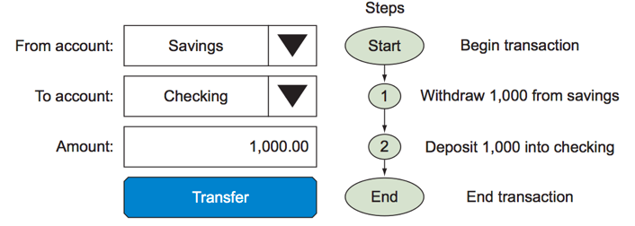
Database Principles: Transactional Integrity
def: Transaction
a unit of work performed against a database
this term generally represents any change in database
involves multiple steps

Slide 10

Database Principles: ACID
def: ACID is a set of properties that guarantee that
database transactions are processed reliably
Atomicity: if one part of the transaction fails, the entire transaction fails;
the database state is left unchanged (‘all or nothing’)
Consistency: ensures that any transaction will bring the database from one valid state to another
Isolation: ensures that the concurrent execution of transactions results in a system state that would be obtained if transactions were executed serially (one after the other)
Durability: ensures that once a transaction has been committed it will be unaffected by power loss, system crashes, or errors

Slide 11
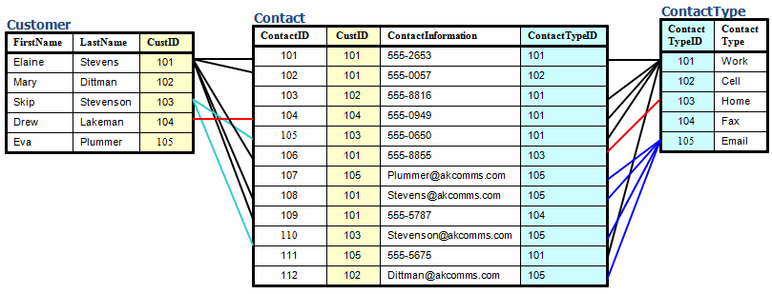
The relational Database Paradigm
each table in a database is devoted to one domain
keys are used to connect tables in a logical manner
customer info in ‘Customer’ table
contacts info in ‘Contact’ table
contact type lookup in ‘ContactType’ table

Slide 12
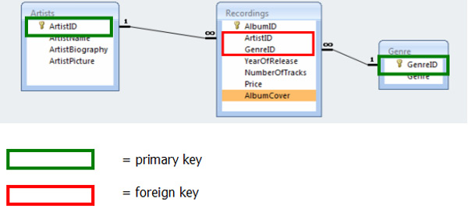
Relational Databases
queries can pull together information from multiple tables by matching foreign keys to primary keys
‘ArtistID’ is:
  a foreign key in the ‘Recordings’ table
  the primary key in the ‘Artists’ table
‘GenreID’ is:
  a foreign key in the ‘Recordings’ table
  the primary key in the ‘Genre’ table

Slide 13
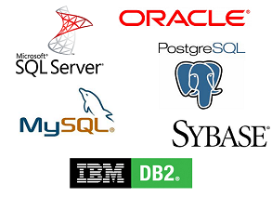


RDBMS
RDB = ?
  relational database
RDBMS = ?
  relational database management system

Slide 14
Database Schema
table-level
  columns and primary key
database-level
  overall design
    data model (tables)
    keys (PK, FK)
  integrity constraints
rationale
  removes tight coupling of database objects and owners
  improves security administration of database objects

Slide 15
SQL (Structured Query Language)
essentially a declarative language
  data are typically retrieved as subsets of the rows and columns in one or more tables: ‘rowsets’
  the user encodes the kind of rowset to be returned
  the database engine produces a plan for how to execute it
    optimised if possible
    may accept hints from user (e.g. indexes to use)
3 functional divisions:
  data definition language (DDL)
    schema creation and modification
  data manipulation language (DML)
    insert, update, delete
  data control language (DCL)
    access, security

Slide 16
SQL – cont’d
simple rowset retrieval:
SELECT columns FROM table
conditional rowset retrieval:
SELECT columns FROM table WHERE condition
example (conditional rowset with ordering):
SELECT TOP 10 amount FROM sales WHERE amount > 99.99 ORDER BY amount

Slide 17
SQL – cont’d
Syntax
identifiers with embedded spaces or punctuation require implementation-specific delimiters
  e.g. SQL Server allows “my table” or [my table]
(delimiters are optional, otherwise)
namespace hierarchies are usually delimited with periods (full stops)
  e.g. (SQL Server): myschema.mytable.mycolumn

Slide 18
SQL – cont’d
Syntax
SQL is case-insensitive
    best to adopt a style, for readability
    (e.g. uppercase for SQL keywords, lowercase for identifiers)
Microsoft and others extend the ANSI standard
  extensions add power and convenience to programming
  many extensions do not readily port between versions of SQL

Slide 19
Primary and Foreign Keys
primary key uniquely refers to each row in a table
  can have only one per table
  usually an integer
foreign key refers to a row in a different table
  is a primary key in the other table
  can have any number per table
Nb. the use of foreign keys reduces storage and makes database maintenance much easier

Slide 20
Joins
used (in queries) for
  combining columns from different tables
  filtering columns from one table using criteria in a different table
joins match a foreign key in one table to a primary key in another table
Nb. simple joins are generally quite fast, but compound joins (involving many tables) can be very slow
a database join is analogous to a set operation in mathematics

Slide 21
Joins – cont’d
Compound inner join example
Return artist name and album cover for every album of the ‘rock’ genre:
SELECT Artists.ArtistName, Recordings.AlbumCover
FROM Artists
INNER JOIN Recordings
ON Artists.ArtistID = Recordings.ArtistID
INNER JOIN Genre
ON Recordings.GenreID = Genre.GenreID
WHERE Genre.Genre = ‘rock’

Slide 22
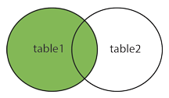
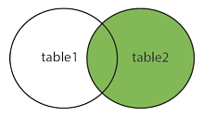
Joins – cont’d
Left Join
all rows from 1st table, plus matching rows from 2nd table:
  SELECT cars.car, trucks.truck FROM cars
  LEFT JOIN trucks ON cars.maker = trucks.maker
  unmatched rows will have NULL in place of truck
Right Join
all rows from 2nd table, plus matching rows from 1st table:
  SELECT cars.car, trucks.truck FROM cars
  RIGHT JOIN trucks ON cars.maker = trucks.maker
  unmatched rows will have NULL in place of car
Table 1
aaa
bbb
ccc
ddd
eee
fff
Table 2
aaa
xxx
ccc
yyy
eee
fff

Slide 23
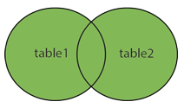
Joins – cont’d
Outer Join
all rows from 1st table, matched with all rows from 2nd table:
  SELECT cars.car, trucks.truck FROM cars
  OUTER JOIN trucks ON cars.maker = trucks.maker
  returns every possible pairing of car and truck
uses:
  creating contingency tables
  creating dummy data for testing
  other?

Slide 24
Database Administration
granting permissions
  users, roles
  tables, views
performing backups & recoveries
creating & scheduling jobs
Nb. It is not uncommon for a query to join tables from different databases
  in SQL Server, the query must be created by the single owner of both databases
  a database owner should be a virtual user -- not a particular person’s login

Slide 25
Database Scripting
shell scripts / commands
  for quick / convenient execution of routine tasks
    populating / updating a database from a file
    backing up or restoring a database
    dumping a database object to a file
    executing queries to deliver rowsets for subsequent analysis
    moving data between databases, data lakes, etc.
examples
  psql -U postgres -d database_name -c "SELECT c_defaults FROM user_info
  WHERE c_uid = 'testuser’”
  mysql -h "server-name" -u "root" "-pXXXXXXXX" "database-name" < "filename.sql"

Slide 26
Advanced SQL
Aggregation functions
Grouping
Window functions

Slide 27
SQL Aggregation functions
aggregate many rows into a single resultant row
common aggregation functions:
  COUNT counts all rows meeting criterion
  SUM sums selected field(s) in all rows meeting criterion
  AVG averages …
  MIN, MAX computes minimum/maximum of …
SQL engine may support user-defined aggregation functions
example:
SELECT MIN(sale_date) AS firstdt, MAX(sale_date) AS lastdt,
SUM(sales) AS netsales FROM sales

Slide 28
Aggregating by Groups in SQL
grouping allows aggregation functions to be applied to subsets based on row-level criteria
adds GROUP BY clause to select statement
example:
SELECT agent_name, SUM(sales) AS netsales FROM sales
GROUP BY agent_name

Slide 29
SQL Window Functions
operates on a set of rows and return a value for each row
  like aggregation, but performed in relation to current row
example: running total
  SELECT duration, SUM(duration)
  OVER (ORDER BY start_time) AS running_total
  FROM bikeshare
  OVER clause designates window
  ORDER BY sets sequence of rowset (oldest to newest values of start_time)
  each row shows current duration and sum of all previous values of duration

Slide 30

Lab 2.1.2: Advanced SQL
Purpose:
  To discover the more powerful features of SQL
Tools and Resources:
  Mode Analytics (account required)
  Mode Analytics interactive SQL tutorial
    https://community.modeanalytics.com/sql/tutorial/introduction-to-sql/

Slide 31
HOMEWORK
Install
  MongoDB Community Server https://www.mongodb.com/download-center#community
  Neo4j Community Server https://neo4j.com/download-center/#releases
Install Python packages:
  pymongo (conda)
  neo4j-driver (pip)

Slide 32

Lab 2.1.3: SQL in Python
Purpose:
  To investigate SQL implementation in Python
Tools and Resources:
  Sqlit: Install on your labtop
        https://www.sqlite.org/download.html
  Jupyter Notebooks
  Python package sqlite3
Materials:
  ‘Lab 2.1.3 – Databases.ipynb’
Data:
  ‘housing-data.csv’

Slide 33




Scalable SQL
massively parallel processing relational database systems (MPP RDBMS)
  (expensive) architecture supports scalability and high performance
NoSQL databases with SQL

Slide 34
NoSQL Databases (example)
Document databases
  MongoDB

Slide 35
Document Databases
semi-structured data
records do not all need to have the same fields
XML:
a record is a block of XML tags and values
JSON:
a record is a list of key:value pairs
<contact>
<firstname>Bob</firstname>
<address>5 Oak St.</lastname>
<hobby>saling</hobby>
</contact>
{
"FirstName": "Bob",
"Address": "5 Oak St.",
"Hobby": "sailing"
}

Slide 36

MongoDB
an open-source document database
  no charge for Community Server version
high performance
  embedded data models reduce I/O activity
  indexes
    can include keys from embedded documents, arrays
high availability
  replication facility
    automatic fail-over
    data redundancy
automatic scalability (horizontal)

Slide 37
MongoDB
CRUD √
  create, read, update, delete
ACID ?
  traditionally:
    document databases are only ACID-compliant only at document level
    no transactions for containing multiple I/O operations
    application code is obliged to emulate transactions, if required
    latency results in an eventual consistency model
  MongoDB 4.0
    introduced transactions

Slide 38
MongoDB: High-Level Objects
Document:
  a set of field:value pairs
    values can be hierarchical
  analogous to RDB row
  examples:
  { name: “sue”, age: 26, status: “A”, groups: [ “news”, “sports” ] }
  { name: “fred”, status: “A”, groups: [ “sports”, “hobbies”, “cars” ] }
  { name: { first: “fred”, last: “bloggs” }, status: “A”, groups: [ “sports”, “hobbies”, “cars” ] }
Collection:
  a logical group of documents
  analogous to RDB table

Slide 39
MongoDB with Python
example:
  import pymongo
  connection = pymongo.MongoClient("mongodb://localhost")
  db = connection.school
  students = db.students
  cursor = students.find()
  # find minimum homework score...
  for doc in cursor:
  scores = doc["scores"]
  minhs = 101
  for entry in scores:
  if entry["type"] == "homework":
  if entry["score"] < minhs:
  minhs = entry["score"]
create mongod client
connect to database ‘school’
create alias for table ‘students’
fetch all rows into cursor
loop through docs in cursor
get value (doc) associated with key ‘scores’
initialise min to impossibly large value (> 100%)
loop through ‘scores’ docs, looking for ‘homework’ keys
test each corresponding score to find new minimum

Slide 40

Lab 2.1.4: Python with MongoDB (Optional homework)
Purpose:
  To develop skills in NoSQL database programming with MongoDB
Materials:
  ‘Lab 2.1.4.ipynb’

Slide 41
Discussion: SQL vs NoSQL
SQL | NoSQL
Traditional rows and columns governed data model | No predefined data structure database at mercy of developers
Strict structure (incl. primary keys) schema changes difficult, risky | Ideal for unstructured data schema can change with application requirements
Entire column for each feature | Cheaper hardware
Industry standard | Supports design flexibility & growth popular among startups
ACID | Application code must manage transactions

Slide 42
Questions?

Slide 43
Appendices

Slide 44
1. Relational Databases

Slide 45
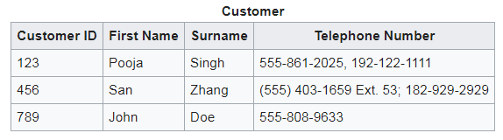
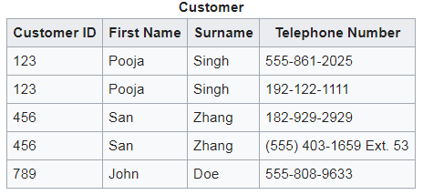
Relational Databases – Normalisation
Codd’s 1st-normal form
the domain of each attribute contains only atomic (indivisible) values
the value of each attribute contains only a single value from that domain

Slide 46
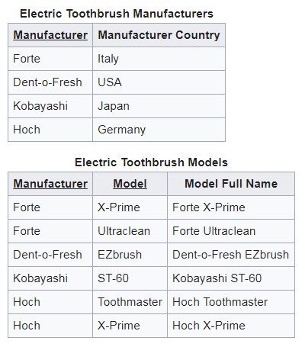
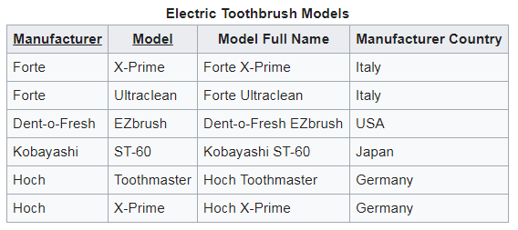
Relational Databases – – Normalisation - cont’d
Codd’s 2nd-normal form
in 1st-normal form
no non-prime attribute is dependent on any proper subset of any candidate key of the relation
(an attribute that is not a part of any candidate key of the relation)

Slide 47
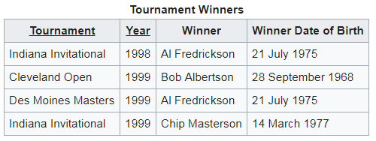
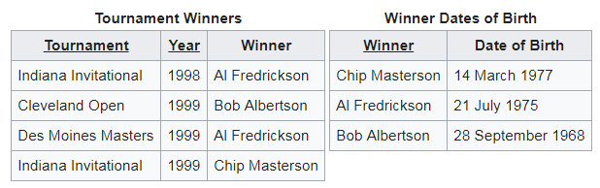
Relational Databases – – Normalisation - cont’d
Codd’s 3rd-normal form
in 2nd-normal form
every non-prime attribute (of a table) is non-transitively dependent on every key (of a table)
?

Slide 48
Which RDBMS Object to Use When
queries
  ad hoc queries
  stored or generated in application code
views
  stored (reusable) queries
  can incorporate joins with other views
  preferable to queries in application code
stored procedures
  more powerful than views (can query and/or modify data)
  preferred for delivering data to applications (security, control, maintainability)
reports
  formatted output containers based on tables, views
  text & graphics
  usually provided via a separate application (designed for but existing outside the RDBMS)
  may have built-in subscription service

Slide 49
Discussion
Why is the RDBMS still in use?
QUESTIONS?

Slide 50
2. SQL

Slide 51

Lab 2.1.1: SQL
Purpose:
  Create account in Mode Analytics
  To discover the basic features of SQL
Tools and Resources:
  Mode Analytics (account required)
Materials:
  Mode Analytics interactive SQL tutorial
  https://community.modeanalytics.com/sql/tutorial/introduction-to-sql/

Slide 52
End of Presentation!

